Slide 1
Simulation of a Production line
By: Pedro Rodriguez

Slide 2


Problem
Production line is experiencing inconsistency in meeting the daily demand.
The focus will be the production line 5
The first 3 stations should produce 600 units

Slide 3

Who might care?
Springboard Mentor
Manufacturing Manager
Manufacturing Engineer
Process Engineer

Slide 4
What factors can be affecting the process?
Supplier
Materials
Equipment
Process time
Available labor and human error

Slide 5
Data Information
station | production_line | Cycle_time
1 | 1 | 96.20
2 | 1 | 22.20
3 | 2 | 7.25
4 | 2 | 11.67
5 | 2 | 75.25
station | station_no. | Date | Downtime | Year
station 1 | 1 | 2018-01-01 | 8 | 2018
station 2 | 2 | 2018-01-01 | 8 | 2018
station 3 | 3 | 2018-01-01 | 4 | 2018
station 4 | 4 | 2018-01-01 | 7 | 2018
station 5 | 5 | 2018-01-01 | 6 | 2018
station | station_no. | Downtime
station 1 | 1 | 2942
station 2 | 2 | 605
station 3 | 3 | 717
station 4 | 4 | 1014
station 5 | 5 | 1743

Slide 6
Understanding the currently line
Takt time is the rate at which you need to complete a product to meet customer demand.
Total Available Production Time
Takt time =
Average Customer Demand
Takt time = 65.89 second per unit

Slide 7
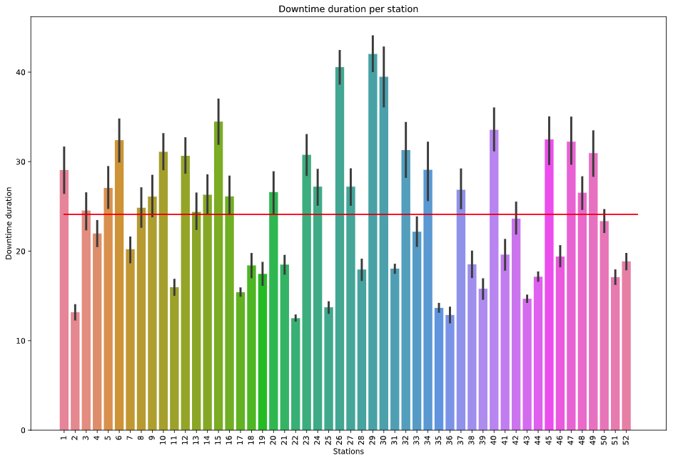
Downtime durations
The mean downtime duration is 24.11 minutes with a standard deviation of 11.91 minutes.
In every Downtime the lines are not producing an average of 21 units per station downtime.
More information is needed

Slide 8
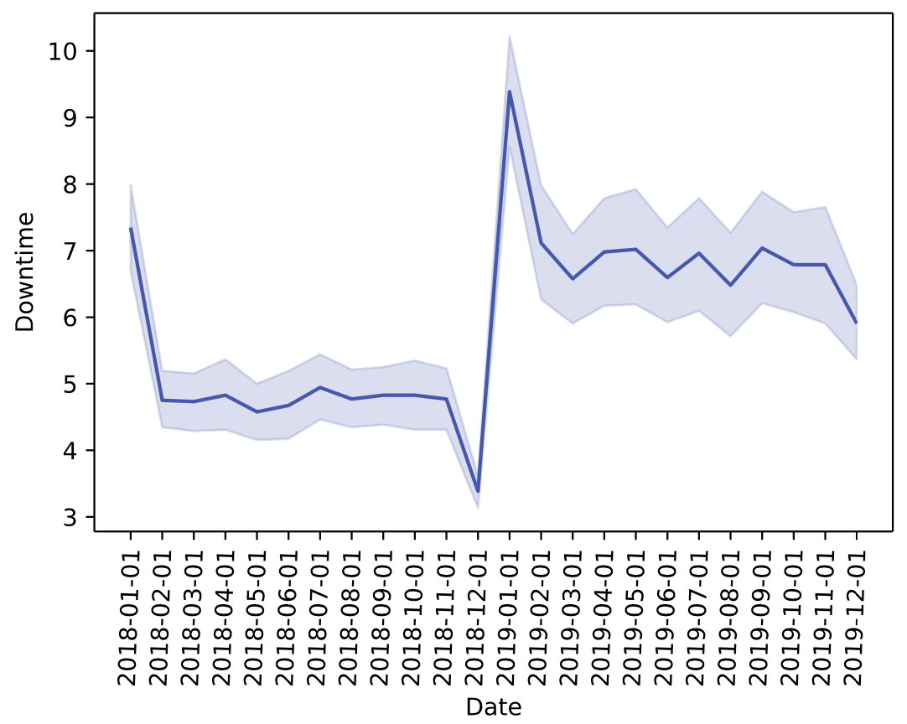
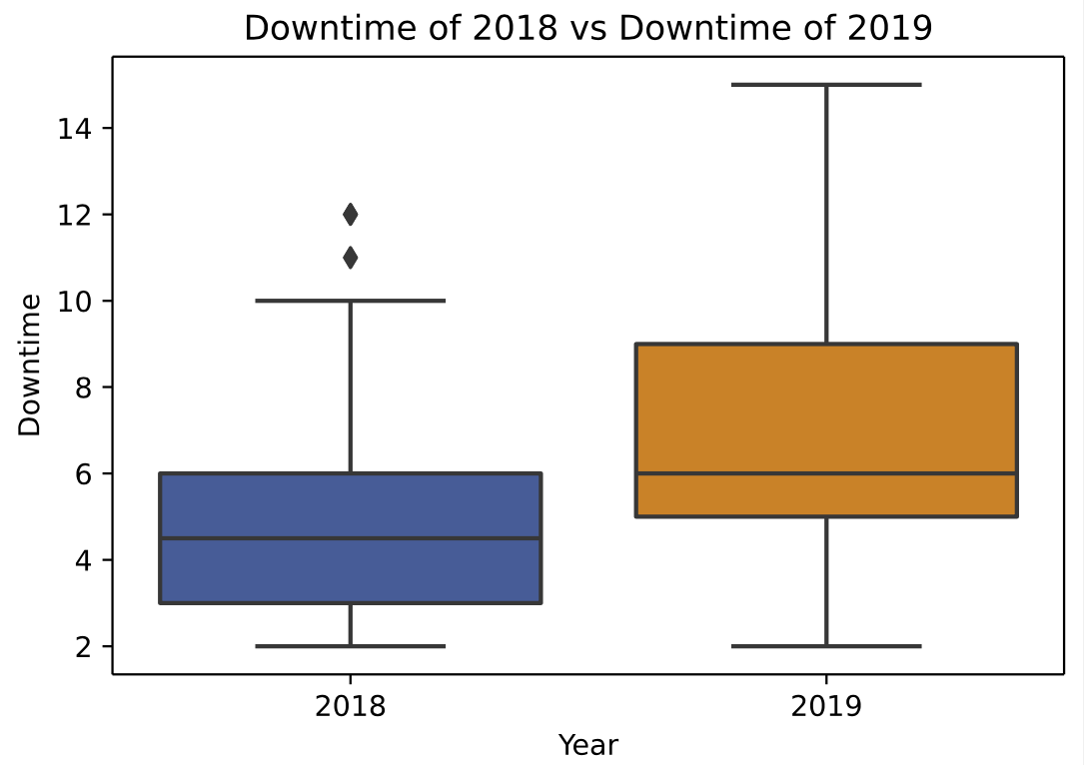
Downtime frequency
Ttest_indResult(
statistic=-14.61679464448569,
pvalue=8.912783594431311e-45)

Slide 9
Simulation
Supplier
Dispatch
Station 1
Station 2
Station 3
56 units per hour
Mean: 17 sec
Std: 2 sec
Mean: 13 sec
Std: 3 sec
Mean: 16 sec
Std: 2 sec
600 units at the end of the shift
Facts:
Production line 4 should regularly supply 56 units per hour.
To have enough supply for the Production line six and seven to complete the daily goal, the production line 5 need the first three stations to produce 600 units.
Notes:
SimPy is a process-based discrete-event simulation framework based on standard Python. Processes in SimPy are defined by Python generator functions and may, for example, be used to model active components like customers, vehicles or agents

Slide 10
Simulation run
First Run
STARTING SIMULATION
------------------------------
RUNNING TIME: 12 hours
------------------------------
Production line has 588 units processed
------------------------------
SIMULATION COMPLETED
Actual Process Parameter:
num_station_1 = 1
mean_station_1 = 17
std_station_1 = 2
num_station_2 = 1
mean_station_2 = 14
std_station_2 = 3
num_station_3 = 1
mean_station_3 = 16
std_station_3 = 2
Second Run
STARTING SIMULATION
------------------------------
RUNNING TIME: 12 hours
------------------------------
Production line has 600 units processed
------------------------------
SIMULATION COMPLETED
Third Run
STARTING SIMULATION
------------------------------
RUNNING TIME: 12 hours
------------------------------
Production line has 600 units processed
------------------------------
SIMULATION COMPLETED

Slide 11
Simulation run Test #1
First Run
STARTING SIMULATION
------------------------------
RUNNING TIME: 12 hours
------------------------------
Production line has 588 units processed
------------------------------
SIMULATION COMPLETED
Actual Process Parameter:
num_station_1 = 1
mean_station_1 = 17
std_station_1 = 1
num_station_2 = 1
mean_station_2 = 14
std_station_2 = 1
num_station_3 = 1
mean_station_3 = 16
std_station_3 = 1
Second Run
STARTING SIMULATION
------------------------------
RUNNING TIME: 12 hours
------------------------------
Production line has 588 units processed
------------------------------
SIMULATION COMPLETED
Third Run
STARTING SIMULATION
------------------------------
RUNNING TIME: 12 hours
------------------------------
Production line has 600 units processed
------------------------------
SIMULATION COMPLETED

Slide 12
Simulation run Test #2
First Run
STARTING SIMULATION
------------------------------
RUNNING TIME: 12 hours
------------------------------
Production line has 636 units processed
------------------------------
SIMULATION COMPLETED
Actual Process Parameter:
num_station_1 = 1
mean_station_1 = 17
std_station_1 = 2
num_station_2 = 1
mean_station_2 = 14
std_station_2 = 3
num_station_3 = 1
mean_station_3 = 15
std_station_3 = 2
Second Run
STARTING SIMULATION
------------------------------
RUNNING TIME: 12 hours
------------------------------
Production line has 648 units processed
------------------------------
SIMULATION COMPLETED
Third Run
STARTING SIMULATION
------------------------------
RUNNING TIME: 12 hours
------------------------------
Production line has 624 units processed
------------------------------
SIMULATION COMPLETED

Slide 13

Future Improvement
In the future, I would like to spend more time with the simulation, adding more constrain to see how the process flow behaves.
Adding constraints helps determine which limitations significantly impact the line and support the management in maximizing the output.

